Slide 1

COMP90050
Advanced Database Systems
Winter Semester, 2023
Lecturer: Farhana Choudhury (PhD)
Week 1 part 3

Slide 2
Core Concepts of Database management system
Efficiency
- Disks and I/O bandwidth
- Main memory
- Type of architecture
Database performance metrics
Hardware
Software/ DB tuning
- Types of DB
- Indexing
- Query optimisation
Efficiency/speed
Effectiveness
Effectiveness
Concurrent users
Users reading and writing over the same data
Security & Reliability
Transactions
Required tasks are all done together
Reliability
Crash recovery
Hardware:
Arrangement of multiple disks
Voting among multiple disks/modules
Fault tolerance
Data duplication

Slide 3
Fault Tolerance
The property that enables a system to continue operating properly in the event of the failure of some of its components.

Slide 4
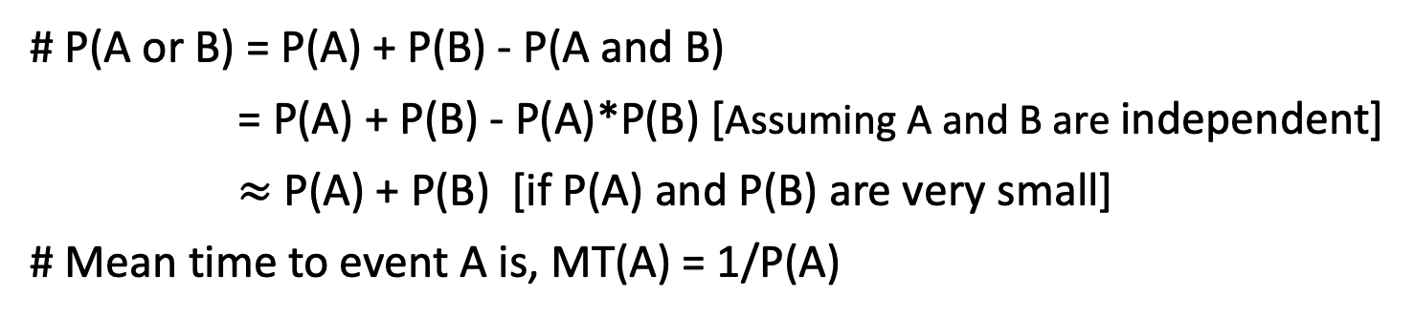
Some statistics first!
A
B
# P(A) = probability of an event A is happening in a certain period.
# P(A and B) = probability both A and B happening in that period
= P(A)*P(B) assuming A and B are independent events.
# P(A or B) = P(A) + P(B) - P(A and B)
= P(A) + P(B) - P(A)*P(B) [Assuming A and B are independent]
$≈$ P(A) + P(B) [if P(A) and P(B) are very small]
# Mean time to event A is, MT(A) = 1/P(A)
# If events A, B, have mean time MT(A), MT(B), then the mean time to the first event, MT(A or B) = 1/P(A or B)
Notes:
the time elapsing before an event is experienced

Slide 5
If there are n events, each with the same probability p, then
Probability that one of the events occur = p + p + …. (n times)
= n*p [assuming p is small]
2. Mean time to one of the events (i.e., mean time to the first event)
= 1/(n*p)
= (1/p) * (1/n)
= m * (1/n) = m/n

Slide 6
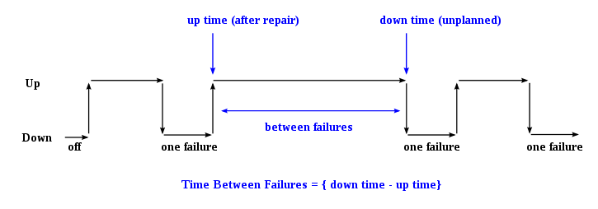
A system’s lifecycle
Module availability : measures the ratio of service accomplishment to elapsed time
Repair time
the time elapsing before a failure is experienced

Slide 7
Fault tolerance by RAID
Redundant Array of Independent Disks – different ways to combine multiple disks as a unit for fault tolerance or performance improvement, or both of a database system

Slide 8
RAID 0 (Block level Striping)
A0, A1, A2, ... are contiguous blocks of data of a file
Provides balanced I/O of disk drives –throughput ~doubles
Any disk failure will be catastrophic and MTTF reduces by a factor of 2
Higher throughput at the cost of increased vulnerability to failures
A0
A1
A2
A3
A4
A5
A6
A7
Disk1
Disk2
A means Block (4K or 8K bytes of storage)
MTTF = Mean Time To Failure
Notes:
alternative

Slide 9
RAID 1 (mirroring)
Provides higher read throughput but lower write throughput (half of the total speed –i.e. single disk speed)
Half storage utilization.
MTTF increases substantially (quadratic improvement –i.e. MTTF²!)
Continues to operate as long as 1 disk is functional
A0
A0
A1
A1
A2
A2
A3
A3
Disk1
Disk2
Calculation of MTTF values – in tutorials
A means Block (4K or 8K bytes of storage)
MTTF = Mean Time To Failure

Slide 10
RAID 2 (bit level striping)
Striping takes place at bit level
Provides higher transfer rate (double the single disk)
MTTF reduced by half as in RAID 0
rarely used
b0
b1
b2
b3
b4
b5
b6
b7
Disk1
Disk2
b means bit
MTTF = Mean Time To Failure

Slide 11
RAID 3 (Byte level striping)
B0, B1, B2, B3, .. are bytes of data of file
Striping takes place at byte level
Rarely used
Provides higher transfer rate as in RAID 0
P0 is parity for bytes B0 and B1
P_{i} = B_{2i} B_{2i+1, here} _{is exclusive-or operator}
MTTF increases substantially (1/3 of RAID1 = MTTF²/3), as 1 disk failure can be recovered from the data of the other 2 disks
B0
B1
P0
B2
B3
P1
B4
B5
P2
B6
B7
P3
Disk1
Disk2
Disk3
⊕
⊕
B means Byte
P is parity
MTTF = Mean Time To Failure
Parity (or check bits) are used for
error detection

Slide 12
RAID 4 (Block level level striping)
Striping takes place at block level
Dedicated disk for parity blocks
Provides higher throughput but very slow writes. Disk3 has more writes as Parity needs to be updated for every data write.
MTTF increases substantially (same as RAID3)
Pi = A_{2i} A_{2i+1}, here ⊕ is an exclusive-or operator
A0
A1
P0
A2
A3
P1
A4
A5
P2
A6
A7
P3
Disk1
Disk2
Disk3
⊕
A means Block (4K or 8K bytes of storage)
P is parity
MTTF = Mean Time To Failure

Slide 13
RAID 5 with 3 disks (Block level striping)
A0,A1, A2, A3, .. are contiguous blocks of data of a file
Striping takes place at block level
Parity blocks are also striped
Provides higher throughput but slower writes but better than RAID 4 as Parity bits are distributed among all disks and the number of write operations on average equal among all 3 disks.
MTTF increases substantially (same as RAID3)
Pi = A_{2i} ⊕ A_{2i+1}, here ⊕ is an exclusive-or operator
A0
A1
P0
A2
P1
A3
P2
A4
A5
A6
A7
P3
Disk1
Disk2
Disk3
A means Block (4K or 8K bytes of storage)
P is parity
MTTF = Mean Time To Failure

Slide 14
RAID 6 (Block level level striping)
A means Block (4K or 8K bytes of storage)
P is parity
A0
A1
A2
P0
P1
A3
A4
P2
P3
A5
A6
P4
P5
A7
A8
P6
P7
A9
A10
A11
Disk1
Disk3
Disk4
Disk5
Disk2
Similar to RAID 5 except two parity bocks used.
Reliability is of the order of MTTF³/10
P0 and P1 are parity blocks for blocks A0, A1 and A2. These are computed in such way that any two disk failures can be safe to recover the data.

Slide 15

Fault Tolerance by voting
Use more than one module, voting for higher reliability
Failvote - Stops if there are no majority agreement
Failfast (voting)- Similar to failvote except the system senses which modules are available and uses the majority of the available modules.
  A 10 module Failfast system continues to operate until the failure of 9 modules where as Failvote stops when 5 modules fail.
  Failfast system has better availability than failvoting (since failvote stops when there is no majority agreement).
100
100
1

Slide 16
Fault Tolerance ...
Failvote needs majority agreement to accept an action (eg, Read/write)
1.
2.
3.
If we start with 10 devices, the system works as long as 6 of them are working. Action is accepted when 6 or more agreeing on the decision.
The moment 5th one fails, system stops as there cannot be 6 devices agreeing
100
100
1
Accept
100
100
1
Accept
100
100
1
Do not accept

Slide 17
Fault Tolerance ...
In Failfast, we are only concerned of majority among the working ones. We are assuming that we can tell which ones are working. Hence we can continue to operate until 2 working ones and if both agree we can proceed with the action. But if they differ the system stops.
  0 devices are faulty, we have 10 working and we need at least 6 to agree
  1 device is faulty, we have 9 working and we need at least 5 to agree
  2 devices are faulty, we have 8 working and we need at least 5 to agree
  3 devices are faulty, we have 7 working and we need at least 4 to agree
  4 devices are faulty, we have 6 working and we need at least 4 to agree
  5 devices are faulty, we have 5 working and we need at least 3 to agree
  6 devices are faulty, we have 4 working and we need at least 3 to agree
  7 devices are faulty, we have 3 working and we need at least 2 to agree
  8 devices are faulty, we have 2 working and we need both to agree
  9 devices are faulty, we have 1working and we have to stop as nothing to compare!

Slide 18
Fault Tolerance for disks
Supermodule – Naturally, a system with multiple hard disk drives is expected to function with only one working disk (use voting when multiple disks are working/available, but still work even when only one is available)

Slide 19
Availability of failvote systems
Consider a system with modules each with MTTF of 10 years
Failvoting with 2 devices:
MTTF = 10/2 = 5 years (system fails with 1 device failure)
Failvoting with 3 devices:
MTTF = 10/3 for the first failure + 10/2 for 2nd failure = 8.3 years.
If there are n events, mean time to the first event = m/n
Lower availability for higher reliability (multiple modules agreeing on a value means that value is more likely to be accurate/reliable)
But, but, but…. cannot we have both??

Slide 20
Fault tolerance with repair
With repair of modules: the faulty equipment is repaired with an average time of MTTR (mean time to repair) as soon as a fault is detected (Sometimes MTTR is just time needed to replace)
Typical Values for recent disks:
  MTTR = Few hours (assuming we stock spare disks) to 1 Day
  MTTF = 750000 hours (~ 86 years) [hard fault]
Probability of a particular module is not available
= MTTR/(MTTF+MTTR) ≅ MTTR/MTTF if MTTF >> MTTR

Slide 21
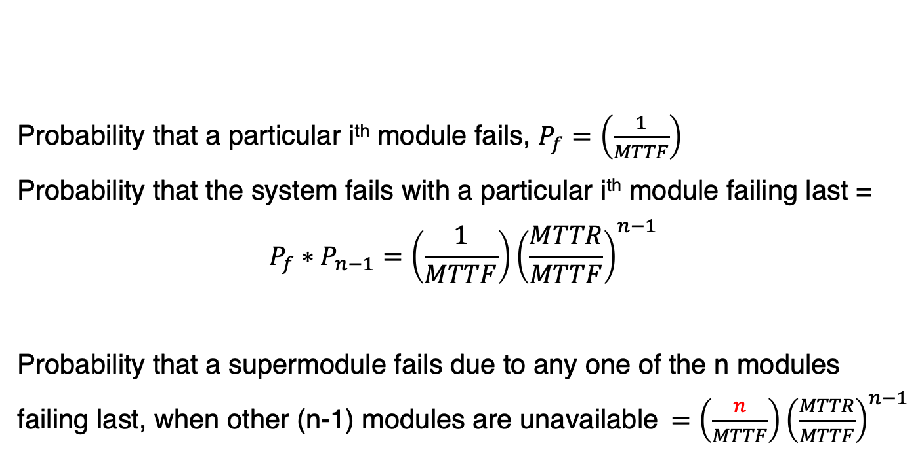
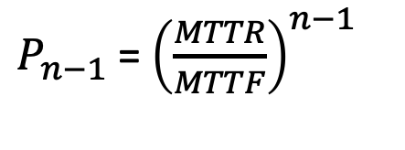
Fault tolerance of a supermodule with repair
Probability that a particular i^{th} module fails, $P_{f}=\left(\frac{1}{MTTF}\right)$
Probability that the system fails with a particular i^{th} module failing last =
$$P_{f}∗P_{n−1}=\left(\frac{1}{MTTF}\right){\left(\frac{MTTR}{MTTF}\right)}^{n−1}$$
Probability that a supermodule fails due to any one of the n modules failing last, when other (n-1) modules are unavailable $=\left(\frac{n}{MTTF}\right){\left(\frac{MTTR}{MTTF}\right)}^{n−1}$
$P_{n−1}$= ${\left(\frac{MTTR}{MTTF}\right)}^{n−1}$
Probability that (n-1) modules are unavailable,
What will this value
for failvote and for failfast?

Slide 22
Communication reliability
Out = #messages sent
In= #messages received
Ack = #acknowledgements
In:6
Ack:3
Out:3
6:Out
6:Ack
3:In

Slide 23
Communication reliability
Out = #messages sent
In= #messages received
Ack = #acknowledgements
In:6
Ack:3
Out:3
7:Out
6:Ack
3:In
7:msg

Slide 24
Communication reliability
Out = #messages sent
In= #messages received
Ack = #acknowledgements
Reliable message passing
In:7
Ack:3
Out:3
7:Out
6:Ack
3:In
7:ack

Slide 25
Communication reliability
Out = #messages sent
In= #messages received
Ack = #acknowledgements
Reliable message passing
In:7
Ack:3
Out:3
7:Out
7:Ack
3:In

Slide 26
Communication reliability
Received message (In3);
Transmitted message(Out6);
Out:6 Ack:6 In:3
Received message (In6);
Transmitted message(Out3);
Out:3 Ack:3 In:6
Checkpoint before sending
a message
Stable storage for Node B
Stable storage for Node A
In:6
Ack:3
Out:3
6:Out
6:Ack
3:In

Slide 27
Communication reliability
Received message (In3);
Record Transmitted message(Out7);
Out:7 Ack:6 In:3
Received message (In6);
Transmitted message(Out3);
Out:3 Ack:3 In:6
Stable storage for Node B
Stable storage for Node A
Checkpoint before sending
a message
In:6
Ack:3
Out:3
7:Out
6:Ack
3:In

Slide 28
Communication reliability
Received message (In3);
Recorded Transmitted message(Out7);
Out:7 Ack:6 In:3
Received message (In6);
Transmitted message(Out3);
Out:3 Ack:3 In:6
Stable storage for Node B
Stable storage for Node A
Checkpoint before sending
a message
In:6
Ack:3
Out:3
7:Out
6:Ack
3:In
7:msg

Slide 29
Communication reliability
Received message (In3);
Transmitted message(Out7);
Out:7 Ack:6 In:3
Received message (In6);
Transmitted message(Out3);
Out:3 Ack:3 In:7
Stable storage for Node B
Stable storage for Node A
Checkpoint before sending
a message
In:7
Ack:3
Out:3
7:Out
6:Ack
3:In

Slide 30
Communication reliability
Received message (In3);
Transmitted message(Out7);
Out:7 Ack:6 In:3
Received message (In7);
Transmitted message(Out3);
Out:3 Ack:3 In:7
Stable storage for Node B
Stable storage for Node A
Checkpoint before sending
a message
In:7
Ack:3
Out:3
7:Out
6:Ack
3:In

Slide 31
Communication reliability
Received message (In3);
Transmitted message(Out7);
Out:7 Ack:6 In:3
Received message (In7);
Transmitted message(Out3);
Out:3 Ack:3 In:7
Stable storage for Node B
Stable storage for Node A
Checkpoint before sending
a message
In:7
Ack:3
Out:3
7:Out
6:Ack
3:In
7:ack

Slide 32
Communication reliability
Received message (In3);
Transmitted message(Out7);
Out:7 Ack:6 In:3
Received message (In7);
Transmitted message(Out3);
Out:3 Ack:3 In:7
Stable storage for Node B
Stable storage for Node A
Checkpoint before sending
a message
In:7
Ack:3
Out:3
7:Out
7:Ack
3:In

Slide 33
Communication reliability
Received message (In3);
Transmitted message(Out7);
Out:7 Ack:7 In:3
Received message (In7);
Transmitted message(Out3);
Out:3 Ack:3 In:7
Stable storage for Node B
Stable storage for Node A
Checkpoint before sending
a message
In:7
Ack:3
Out:3
7:Out
7:Ack
3:In

